Slide 1

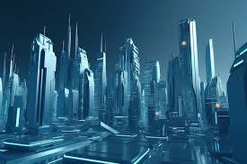
Futuristic Cityscape: Interactive Text-to-Image Generation with Customization
BY
G. YUVA KIRAN
160122749040
CSE-IOT
Mentor ,Internship Incharge
Mrs.N.Sujatha Gupta.
Assistant Professor,
Department of CET

Slide 2
Introduction
Project Overview:
This project develops a system for generating high-quality images from textual descriptions. It integrates AI-driven tools with interactive customization options to provide a seamless user experience.
Significance:
Enhances accessibility and creativity across industries like content creation, education, and entertainment.
Demonstrates the power of AI in bridging the gap between imagination and visuals.

Slide 3
Objectives
Primary Goals:
Convert text prompts into visually coherent and high-quality images.
Enable users to customize generated images (brightness, contrast, blur).
Facilitate seamless storage and sharing via cloud integration.
Broader Impact:
Revolutionizing creative workflows with personalized visuals.

Slide 4
Existing Systems
Comparison:
DALL-E 2: Text-to-image generation and inpainting.
Stable Diffusion: Open-source, versatile text-to-image system.
Adobe Firefly: Advanced editing integrated with Adobe tools.
Google Imagen: Focused on photorealistic image generation.
Unique Aspects of Your System:
Integrated customization features (brightness, contrast, blur).
Easy cloud integration for sharing and storage.

Slide 5
Technologies Used
AI Model: Stable Diffusion v1.5 for high-quality text-to-image generation.
Programming Language: Python, chosen for its simplicity and robust libraries.
Libraries:
Transformers (text processing)
Diffusers (AI model handling)
Pillow (image manipulation)
Accelerate (hardware optimization)
Matplotlib (visualization)
Cloud Integration: Google Drive API for storing and sharing outputs.

Slide 6
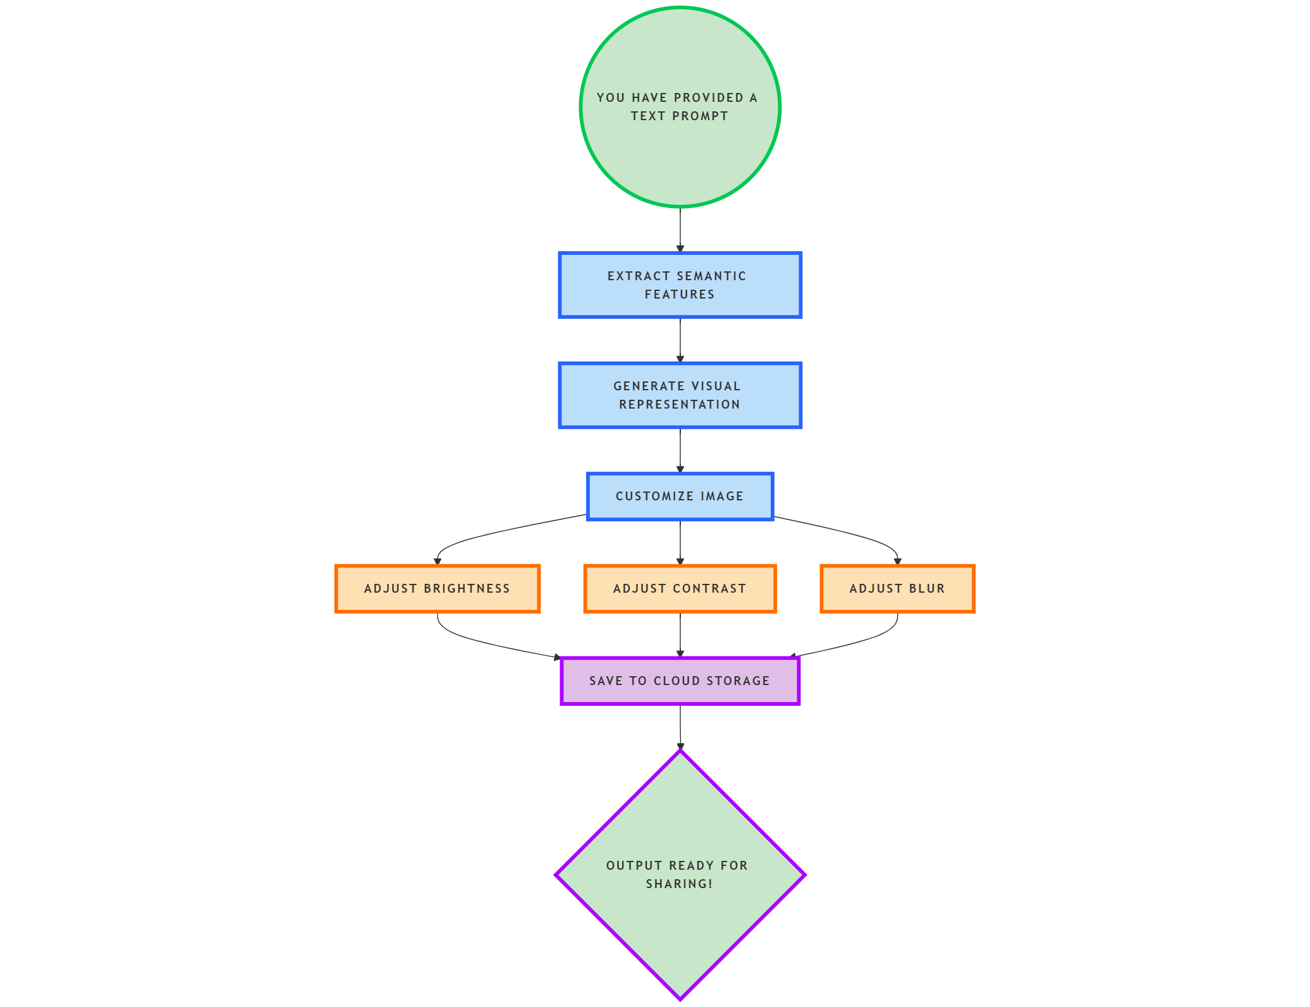
System Architecture
Input: Text prompt from the user.
Semantic Features: Extracted from text for visual representation.
Generator: Creates the image based on semantic features.
Customization: Tools for brightness, contrast, and blur adjustments.
Cloud Storage: Saves outputs for sharing and accessibility.

Slide 7
Workflow
Input: User provides a text description (e.g., "Futuristic cityscape at sunset").
Processing:
Text converted into semantic features.
AI model generates the image based on these features.
Customization:
Users adjust brightness, contrast, and apply filters.
Output:
Generated and edited images are saved locally or on Google Drive.

Slide 8
Code Highlights
Text to Image Generation :
from diffusers import StableDiffusionPipeline
pipe = StableDiffusionPipeline.from_pretrained("runwayml/stable-diffusion-v1-5")
pipe = pipe.to("cuda") # GPU acceleration
text_description = "Futuristic Cityscape"
generated_image = pipe(text_description).images[0]
generated_image.save("generated_image.png")

Slide 9
Customisation
Brightened Image :
from PIL import ImageEnhance
def adjust_brightness(image, factor):
enhancer = ImageEnhance.Brightness(image)
return enhancer.enhance(factor)
brightened_image = adjust_brightness(generated_image, 1.5)
brightened_image.save("brightened_image.png")
Blurred Image
from PIL import ImageFilter
def apply_blur(image, radius):
enhancer = image.filter(ImageFilter.GaussianBlur(radius))
return enhancer
blurred_image = apply_blur(generated_image, 5) # Adjust the radius as needed
blurred_image.save("blurred_image.png")

Slide 10
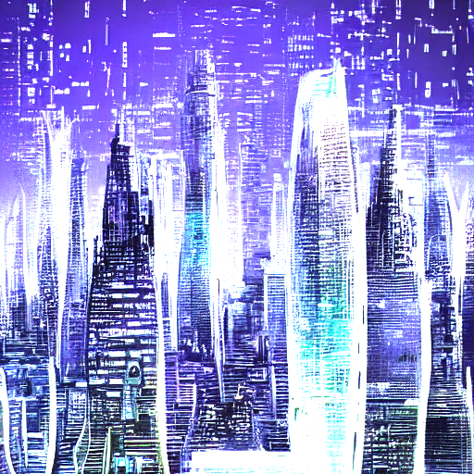
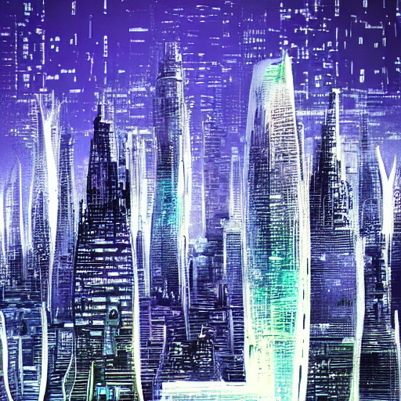
Output
Generated Image : Brightened Image :

Slide 11
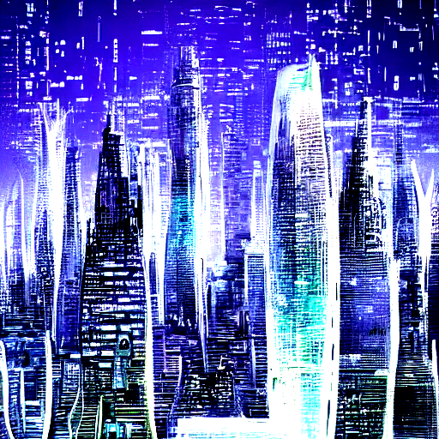

Output
Blurred image contrasted image

Slide 12
Applications
Content Creation: Marketing visuals, storyboarding, and social media assets.
Education: AI-generated datasets and visualization tools for learners.
Entertainment: Designing assets for gaming, movies, and VR environments.
Personalized Art: Custom artworks and branding visuals.

Slide 13
Future Scope
Enhancements:
Advanced editing tools (color grading, style transfer).
Real-time generation for interactive use cases.
3D asset creation for games and VR.
Broader Integration:
Integration with platforms like Adobe Photoshop or AR/VR systems.

